Slide 1
Body language & face expression.
By
M. Kaviya Kumaran
B.Sc II Year .

Slide 2


Slide 3
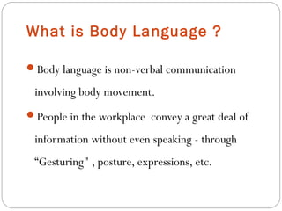

Slide 4
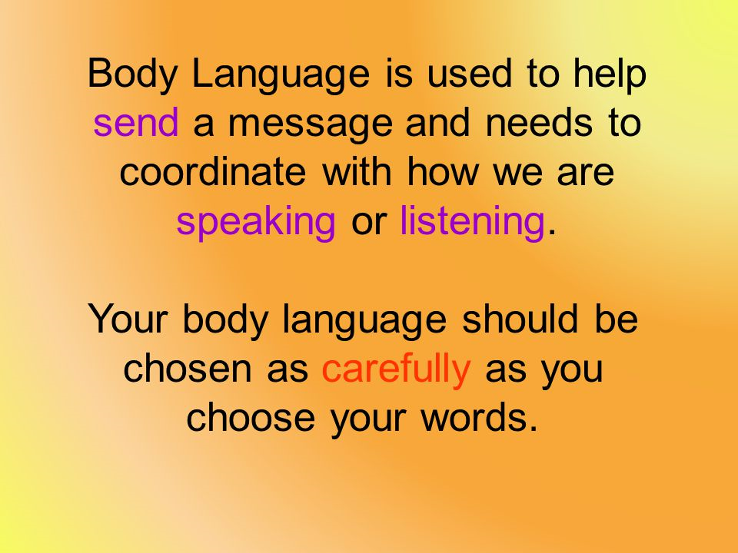

Slide 5
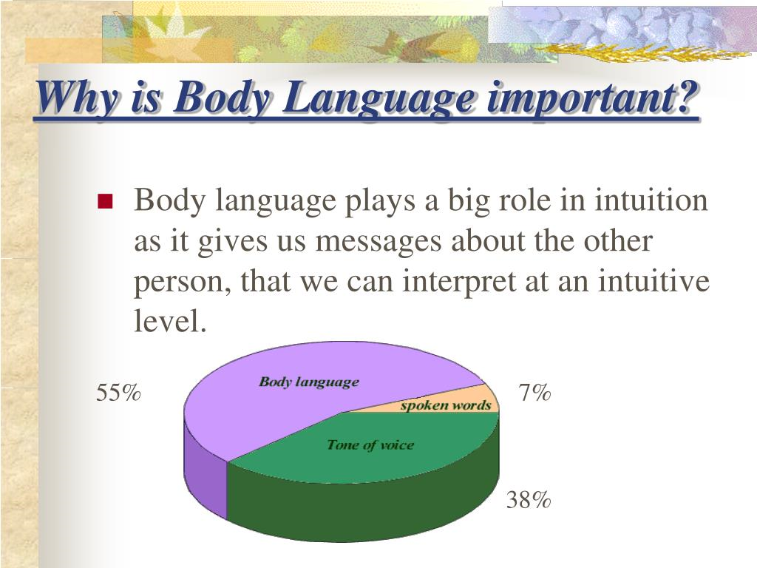

Slide 6


Slide 7
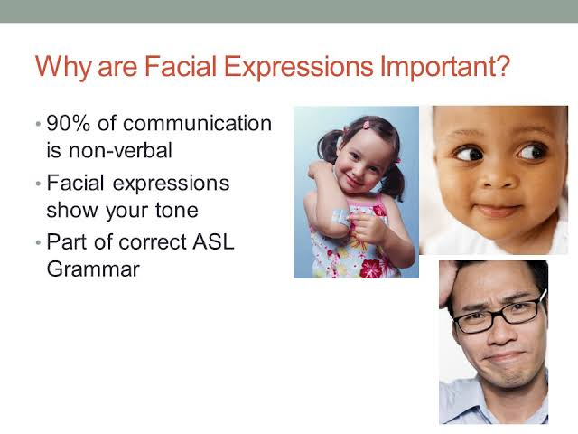

Slide 8
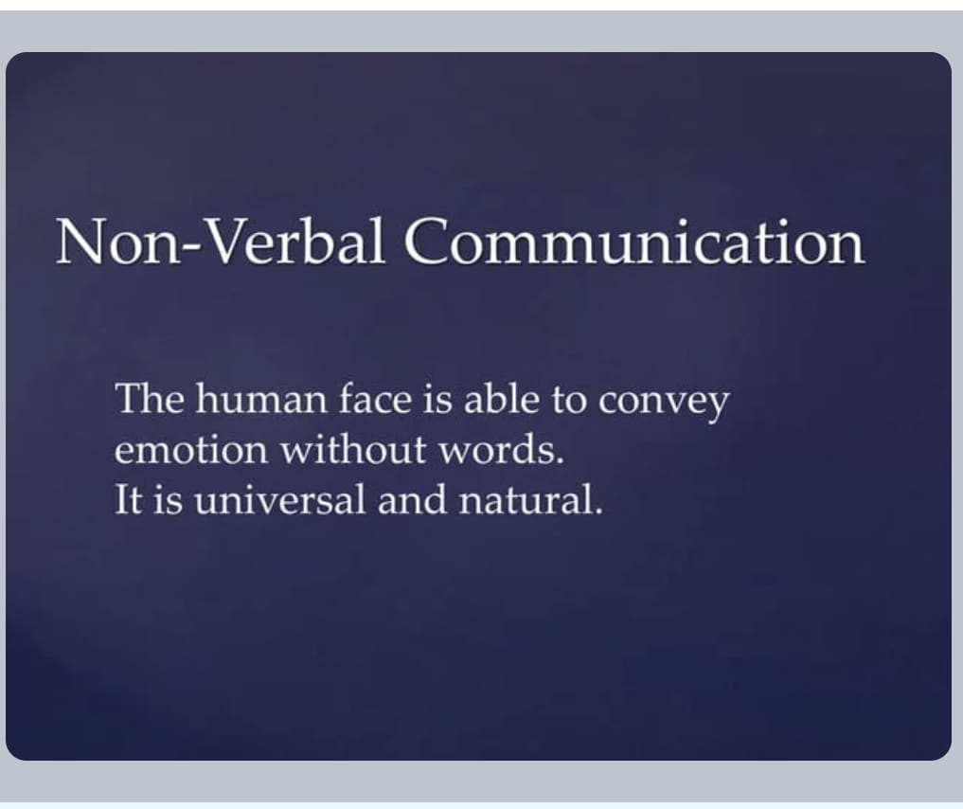

Slide 9
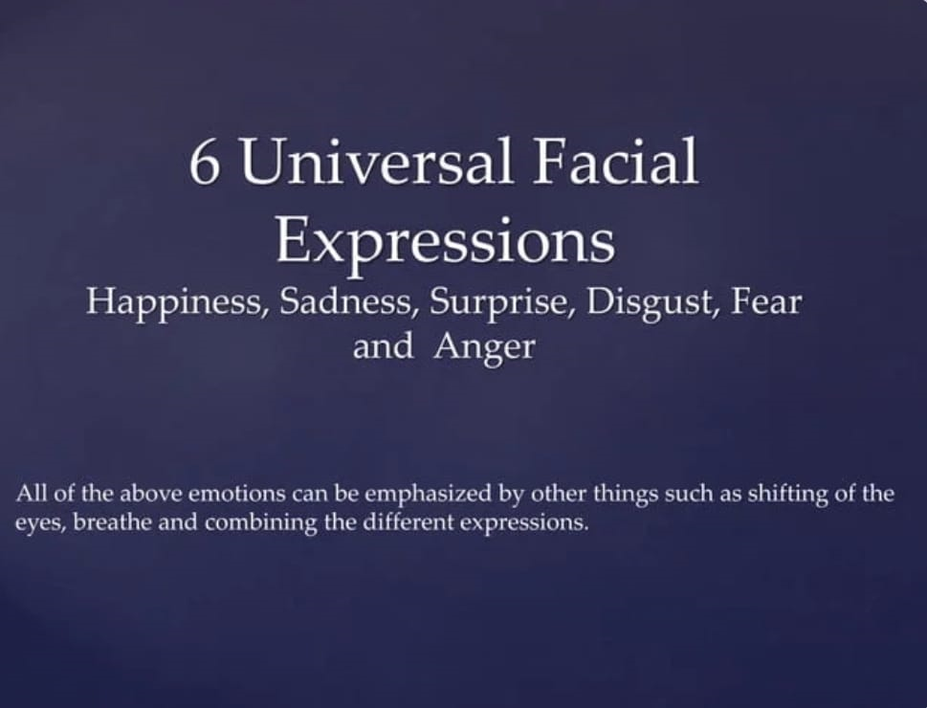

Slide 10


